Slide 1
🚲 Bike Dekho – Bike Sales Analysis Excel/Power BI Project
Project Overview:
The Bike Dekho – Bike Sales Analysis is a hands-on data analysis project that explores sales trends in the biking industry using Microsoft Excel / Power BI. This project demonstrates how Excel can be effectively utilized for data cleaning, transformation, analysis, and visualization to drive meaningful business insights.

Slide 2
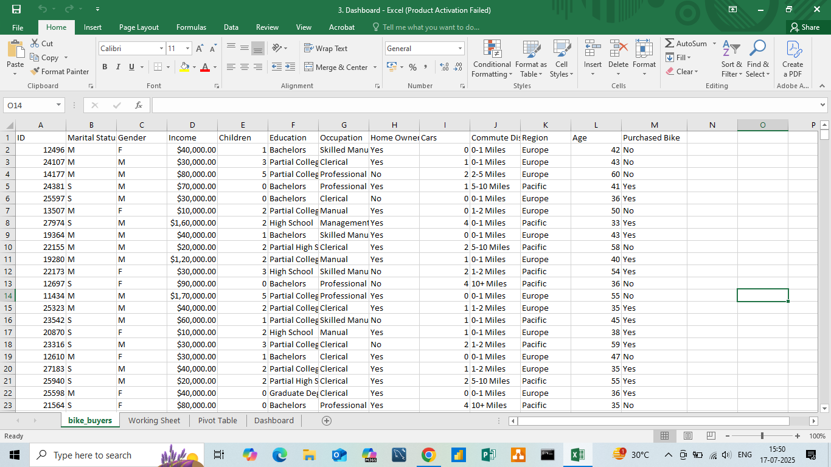
Raw Data

Slide 3
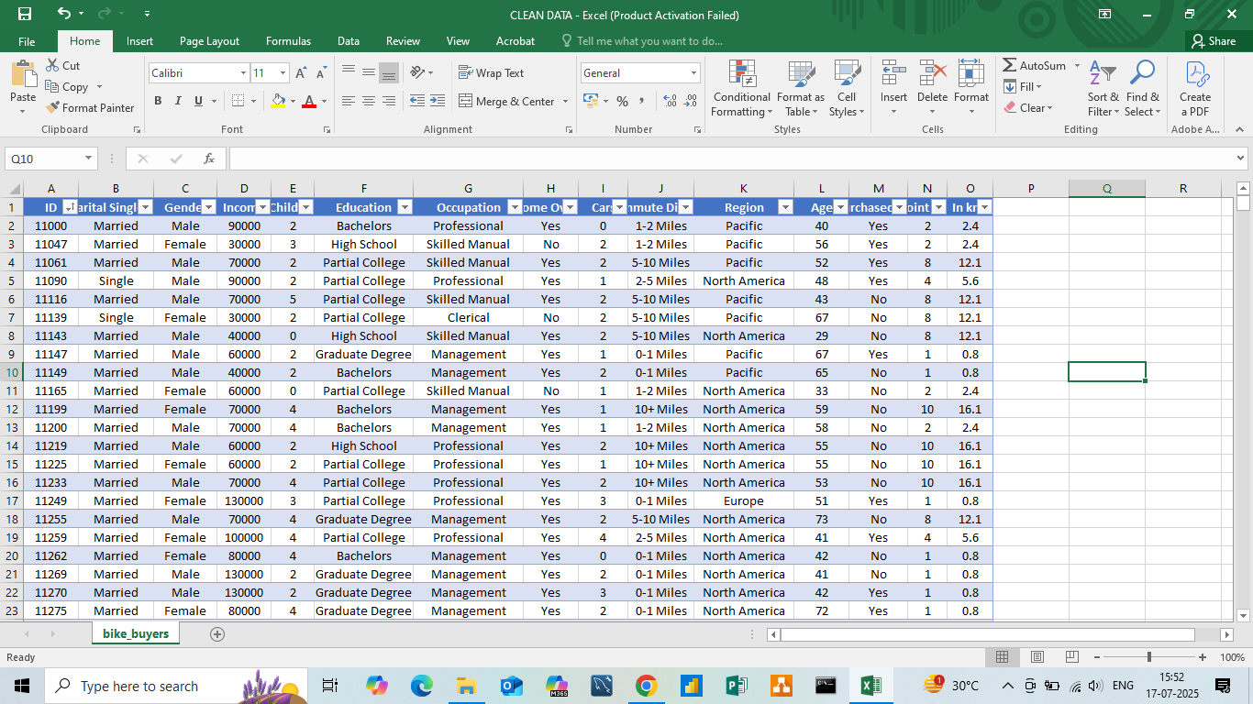
Clean DataSet:- Bike Dekho

Slide 4
Description of Clean DataSet:-
Firstly, we saw the dataset format and changed columns accordingly to the data type format.
After that, we sort the ID column in ascending order.
Then we check whether the null value is there or not in the dataset, and also do the same for the duplicate values.
Now we saw a distance column in the data, which is in the form of miles. So, we made two new columns.
a.)First, the column is for the midpoint of the miles.
b.)Second, the column is for converting the miles into kilometers.
5. The last change in the column of income where $ is present, we change it into a number
format because when we make a chart, it does not take a sign of currency.

Slide 5
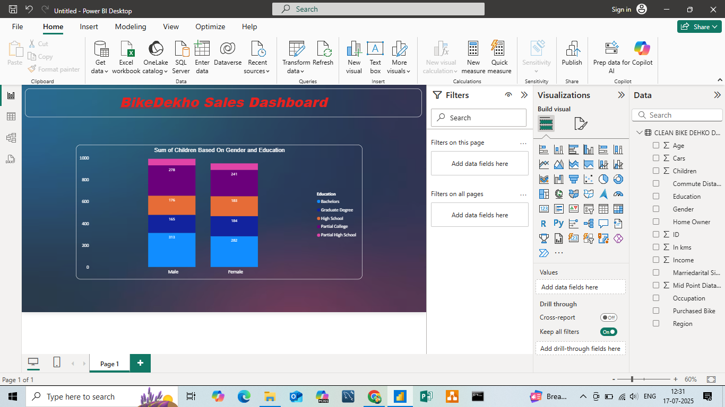
Insights:-Stacked Column Chart
Purpose: To compare the number of children by education level between males and females. Details:
X-axis: Gender (Male, Female)
Y-axis: Sum of Children
Legend: Education Levels (Bachelors, Graduate Degree, High School, Partial College, Partial High School)
Insight: Males have a slightly higher count in most education categories, especially in Bachelor’s and Partial High School education levels.

Slide 6
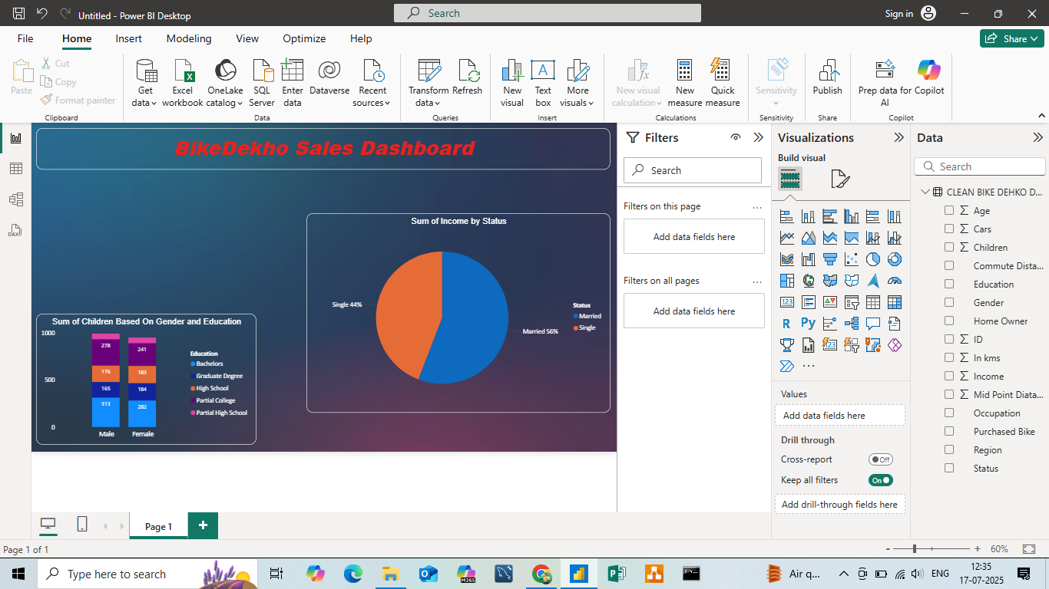
Pie Chart
Purpose: To show the income distribution based on marital status. Details:
Slices represent marital status (Married vs. Single)
Insight: Married individuals contribute 56% of the total income, while singles contribute 44%, indicating higher income from married respondents.

Slide 7
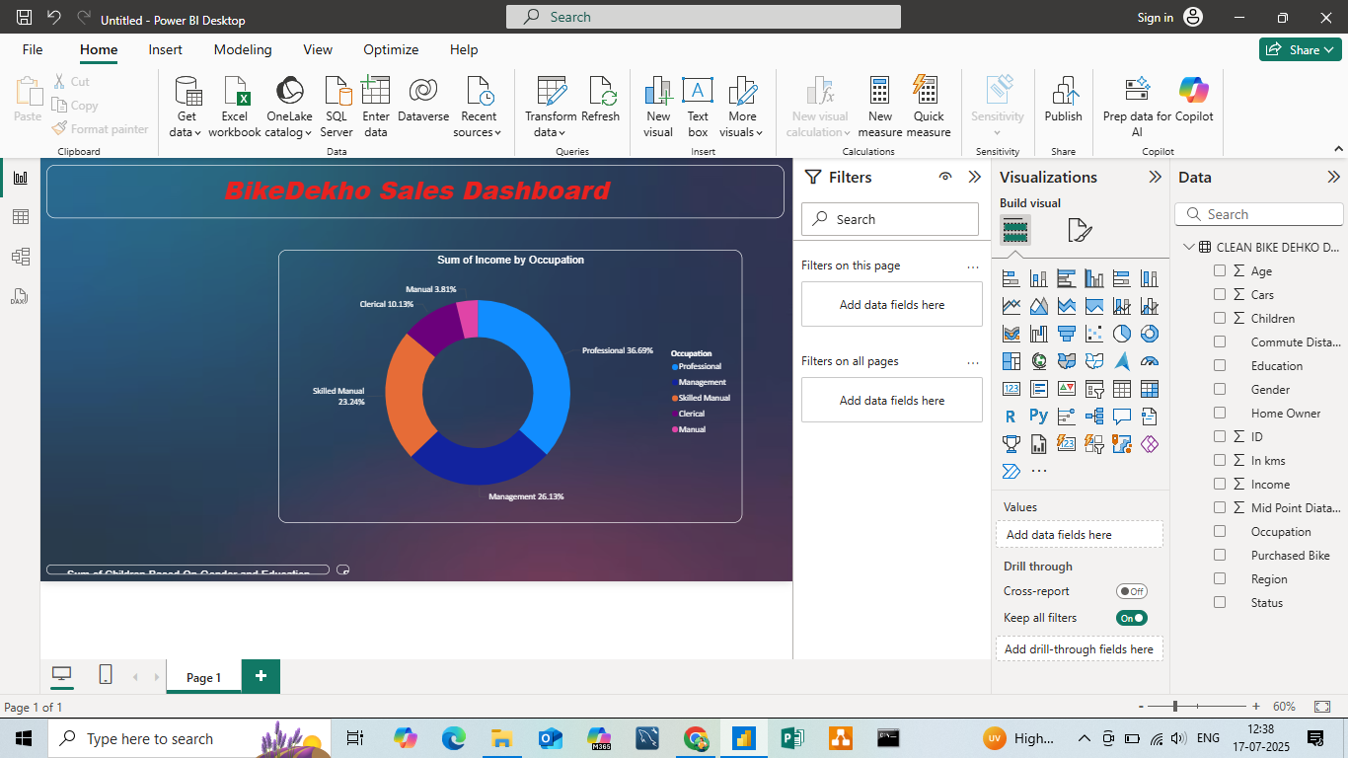
Donut Chart
Purpose: To show which occupations contribute the most to total income. Details:
Slices: Occupation types (Professional, Management, Skilled Manual, Clerical, Manual)
Insight:
Professionals and Management together contribute over 62% of income.
Manual labor contributes the least (~4%).

Slide 8
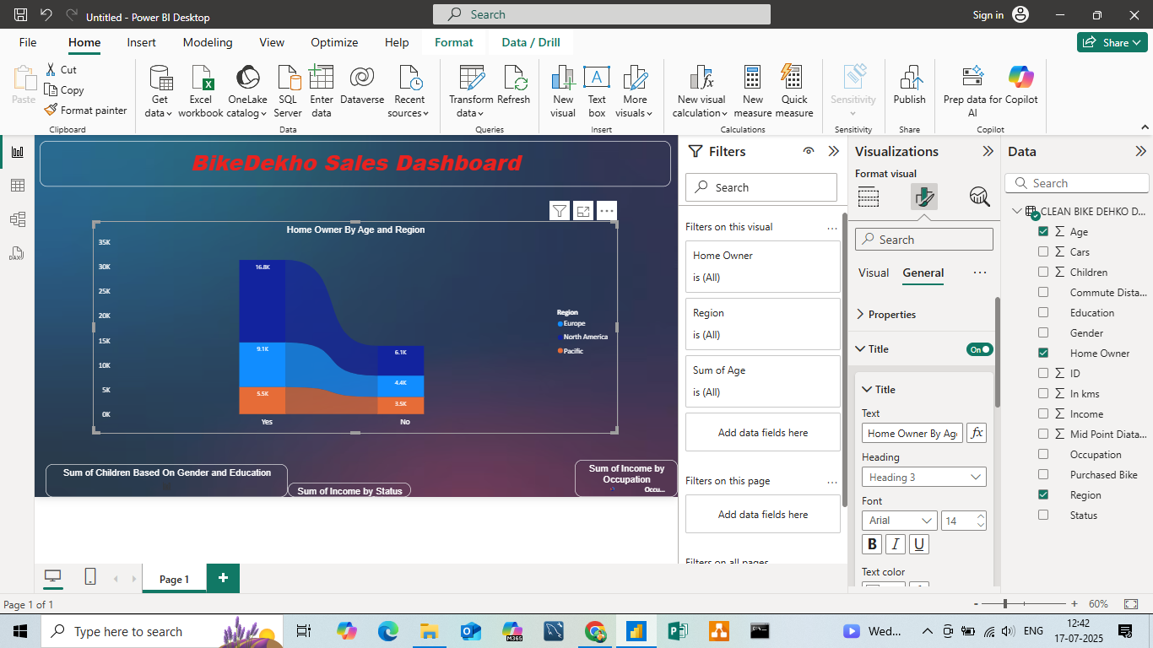
Stacked Area Chart
Purpose: To analyze the relationship between homeownership, age, and geographic region. Details:
X-axis: Home Ownership (Yes/No)
Y-axis: Sum of Age
Legend: Region (Europe, North America, Pacific)
Insight: Majority of older individuals with homes are from North America, followed by Europe. Non-homeowners are fewer in number across all regions.

Slide 9
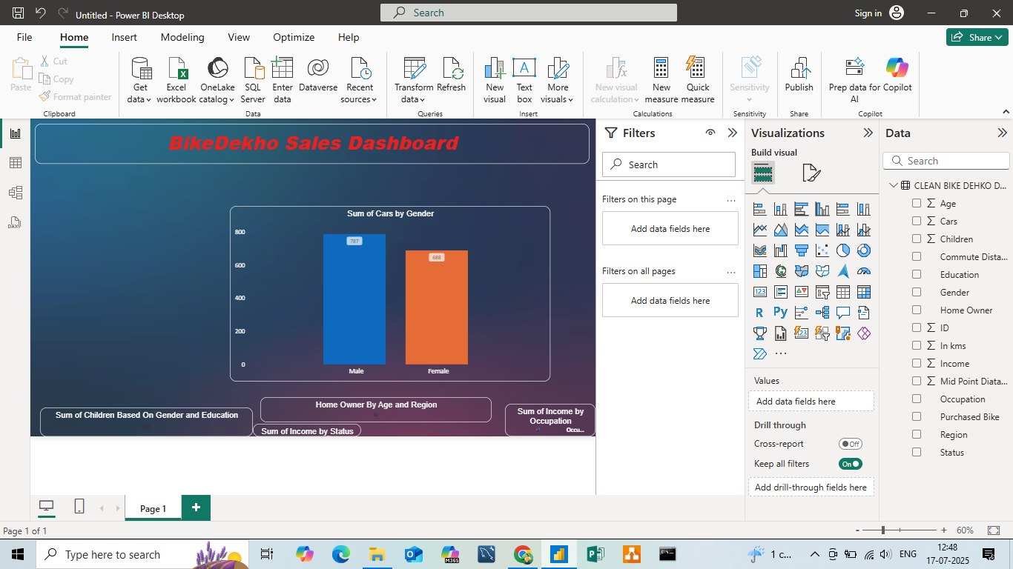
Stacked Bar Chart
Purpose: To compare regional income contributions. Details:
Y-axis: Region (North America, Europe, Pacific)
X-axis: Sum of Income
Insight:
North America contributes the most to total income (32M).
Europe and Pacific contribute equally (13M each).

Slide 10
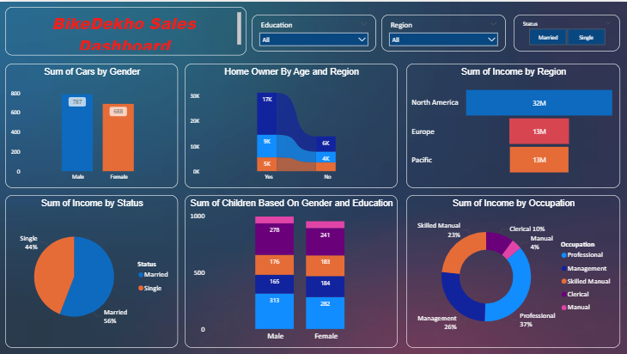
Dashboard

Slide 11
Conclusion – BikeDekho Sales Dashboard
The BikeDekho Sales Dashboard provides valuable insights into customer demographics, income distribution, and buying behavior. Based on the visual analysis, we can draw the following key conclusions:
🚹 Gender and Car Ownership:
Male customers own more cars (787) compared to female customers (688), indicating a higher engagement or purchasing power among male customers.
📈 Income by Marital Status:
Married individuals contribute 56% of total income, while singles contribute 44%, showing a slightly higher financial strength or stability among married users.
🏠 Home Ownership by Age and Region:
Most home-owning customers are older and primarily from North America, suggesting a mature and financially stable user base in that region.
🌍 Regional Income Distribution:
North America dominates income contribution with ₹32M, while Europe and Pacific contribute equally at ₹13M, highlighting North America as the top-performing market.
📊 Income by Occupation:
Professional (37%) and Management (26%) roles lead in income, indicating that high-income customers generally work in white-collar or executive roles.
Manual and Clerical roles contribute the least, which aligns with expected lower income brackets.
👨 Children by Gender and Education:
Education levels are quite balanced across genders, but slightly more males fall under higher education categories (like Bachelors), which may correlate with higher ownership of vehicles.

